Slide 1
SWE 642 – Extra Credit
Group Members:
Meghana Kancherla (G01379905)
Rishitha Sai Kavuru (G01394551)

Slide 2
React concepts
React applications are made up of components. It contains .js files which holds the UI part.
JSX is used in react. Which is an extension for javascript.
State is used in react, which is an object that determines the behavior of a component and how it will render.
We use hooks to manage the state. useState and useEffect hooks.
useState allows to declare a state variable. We can use setSate method for class component.

Slide 3
React - Concepts
useEffect hook allows us to perform functional components.
To access the backend we use fetch. The fetch function takes one argument atleast and returns a promise that gives a response to that request.
It is an asynchronous operation where we use async and await syntax.

Slide 4
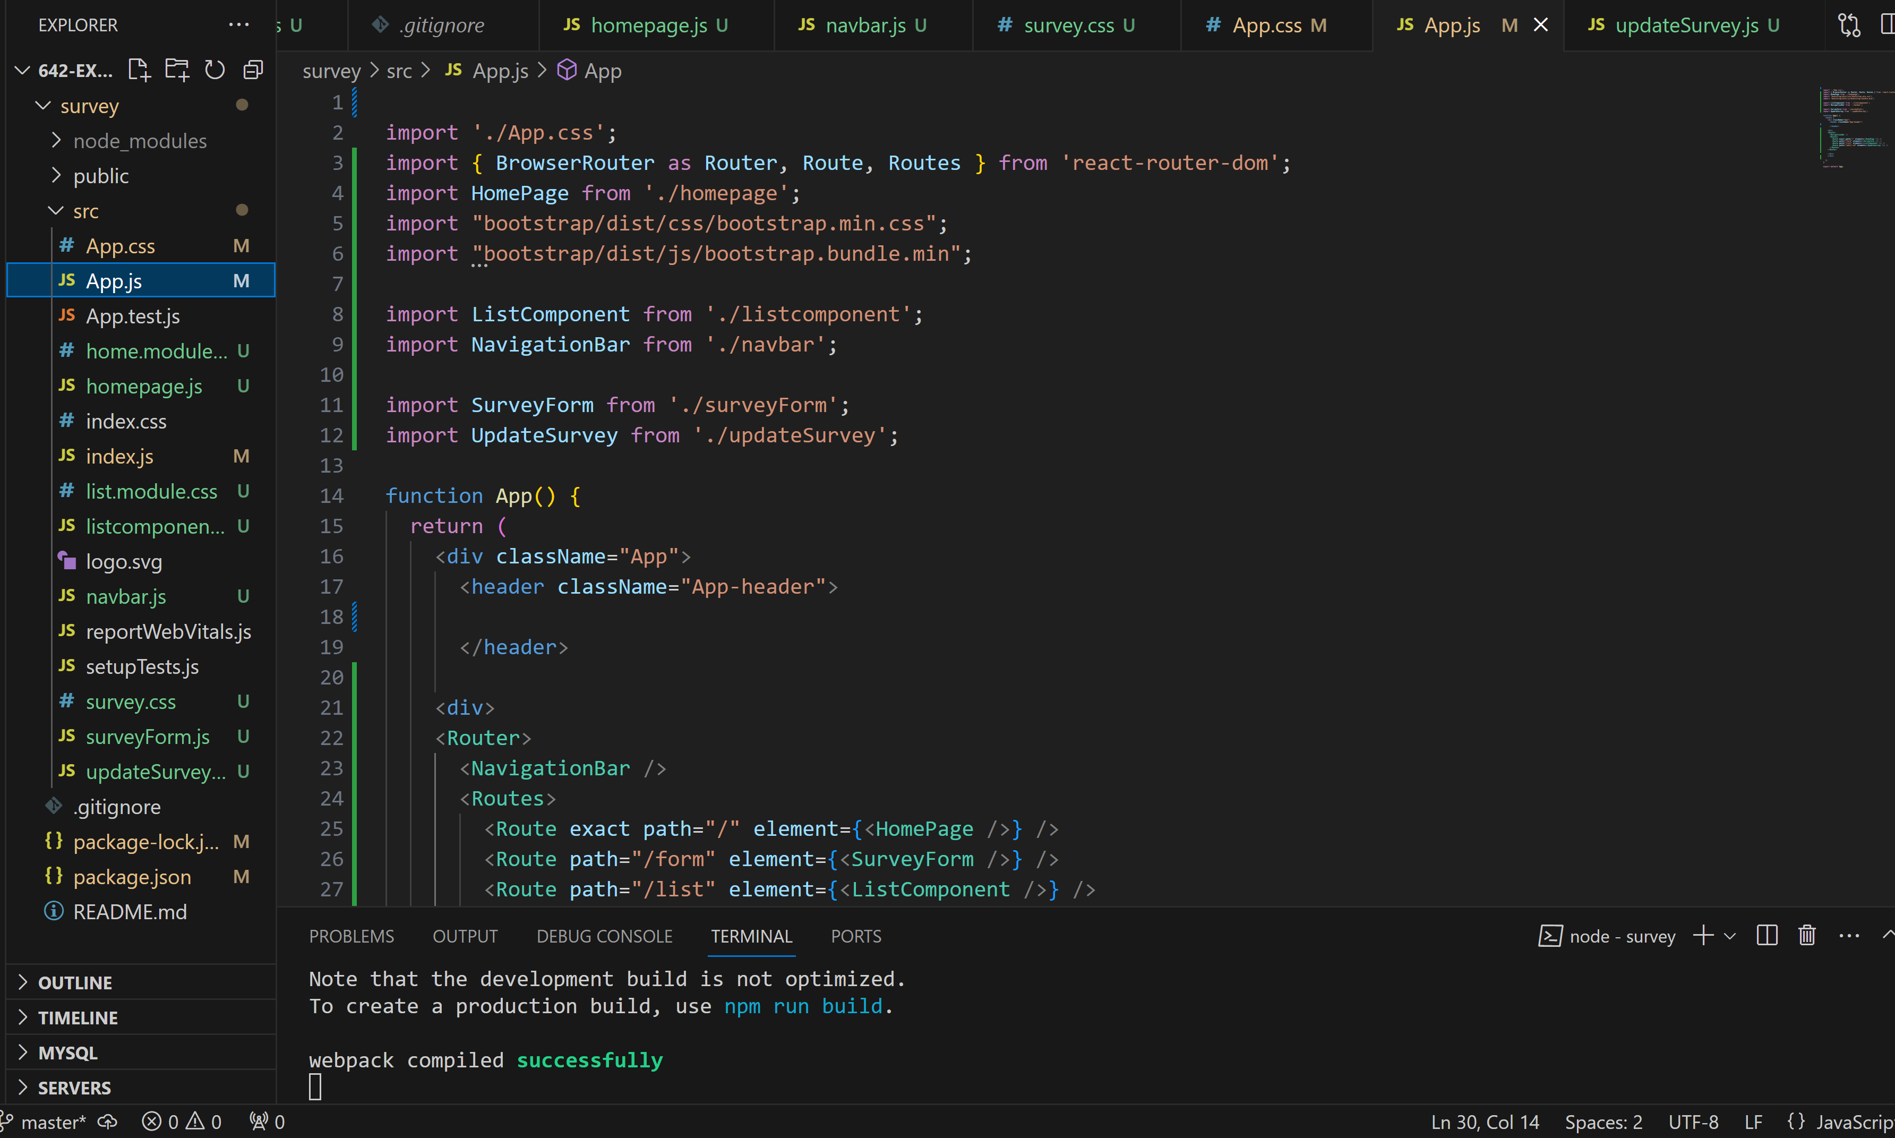
React Implementation – App.js

Slide 5
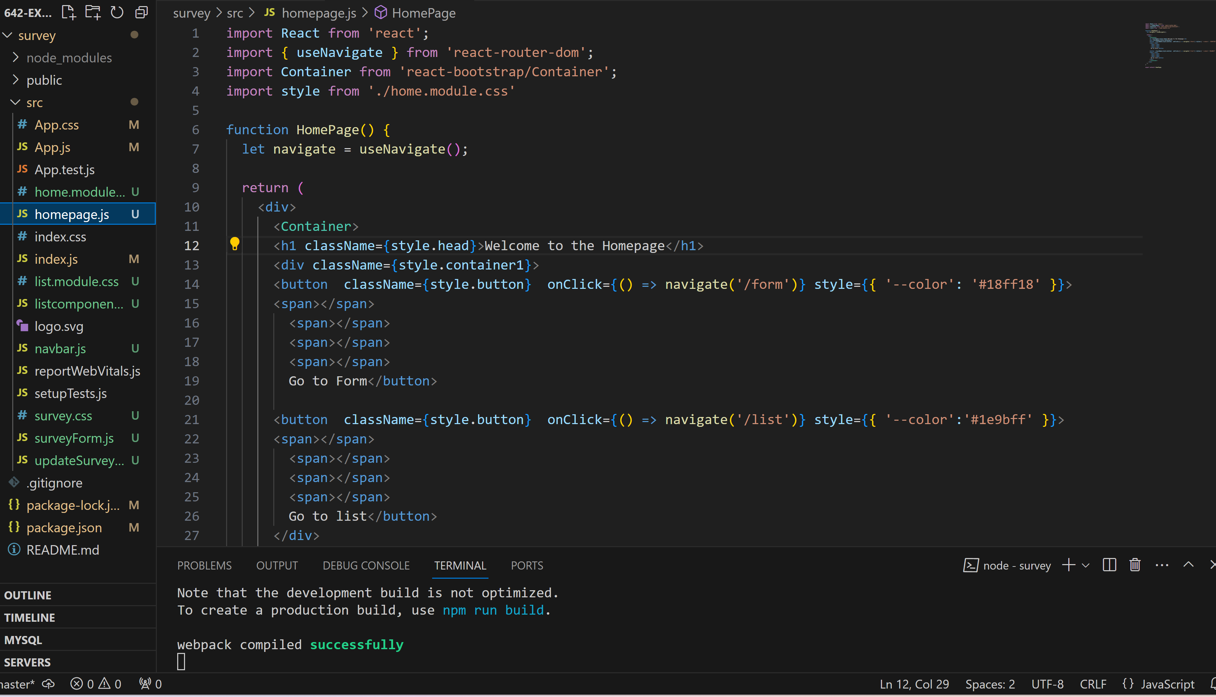
React Implementation – HomePage.js

Slide 6
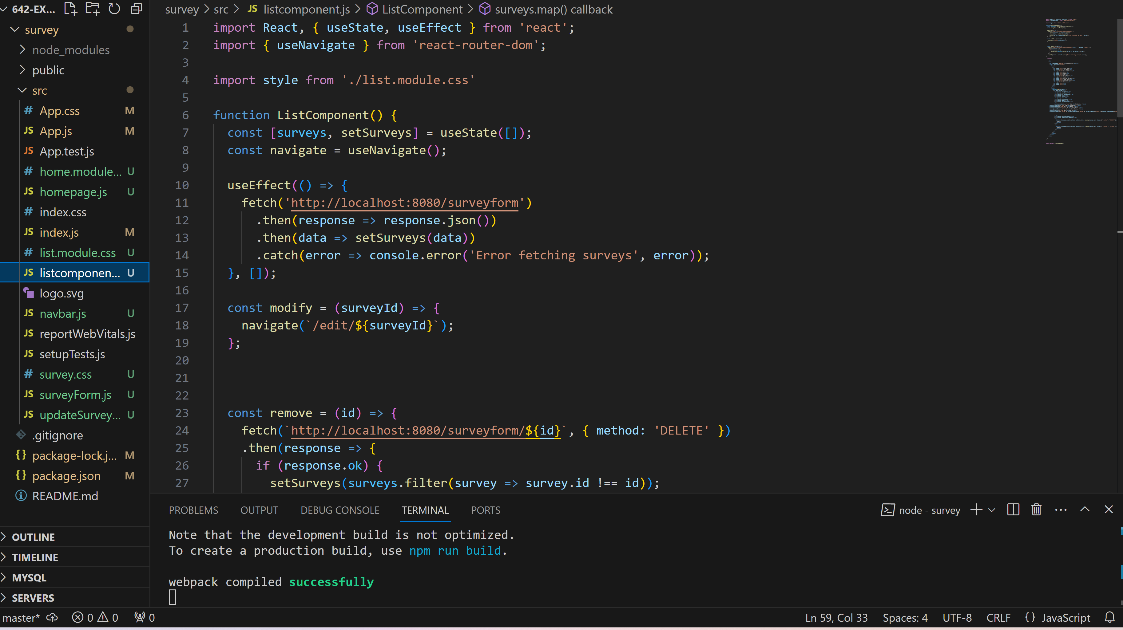
React Implementation – ListComponent.js

Slide 7
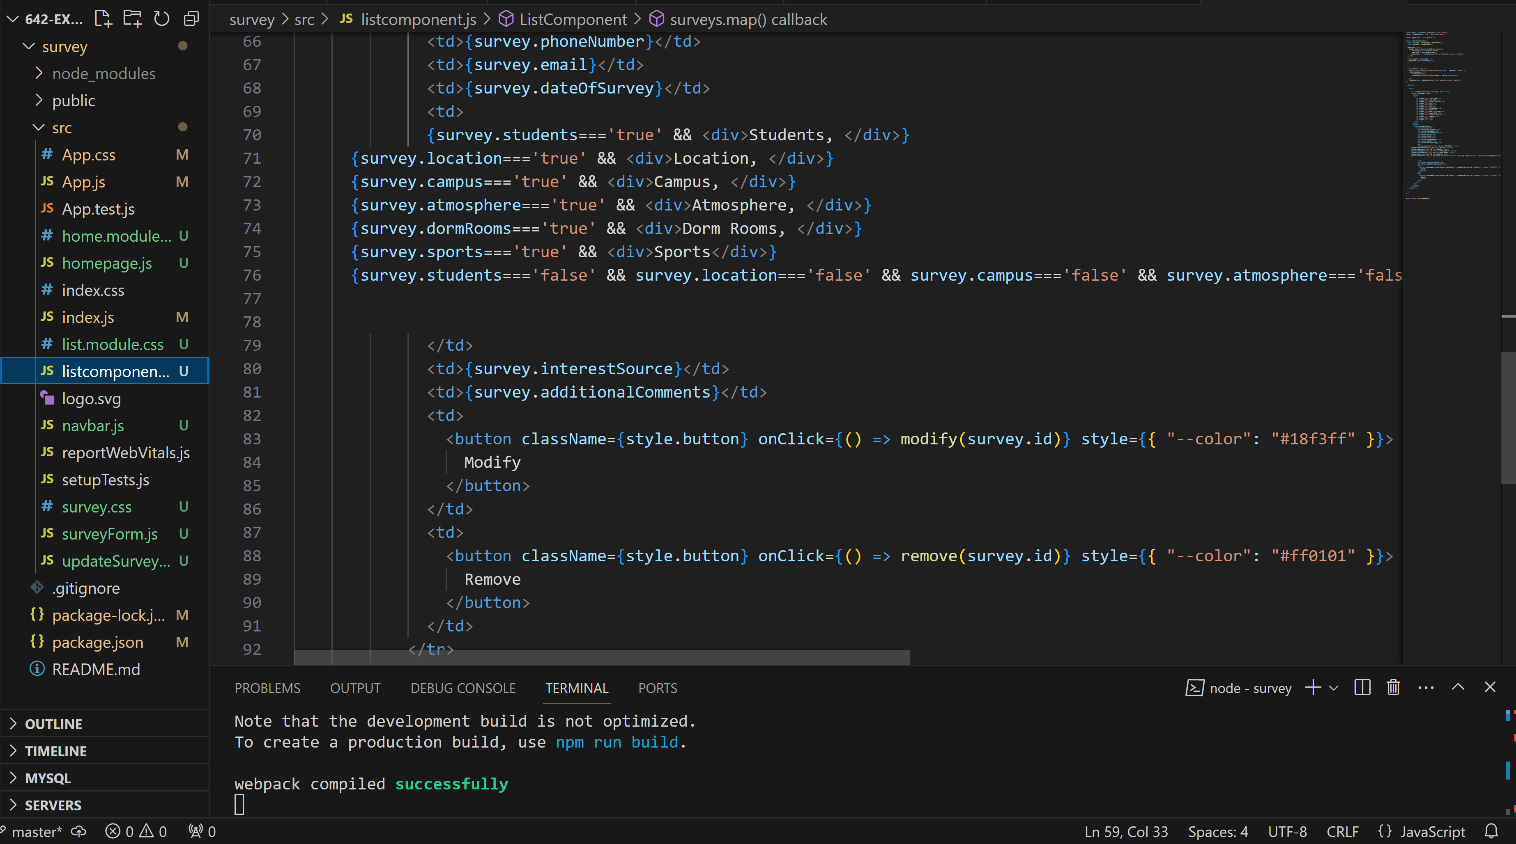
React Implementation – ListComponent.js

Slide 8
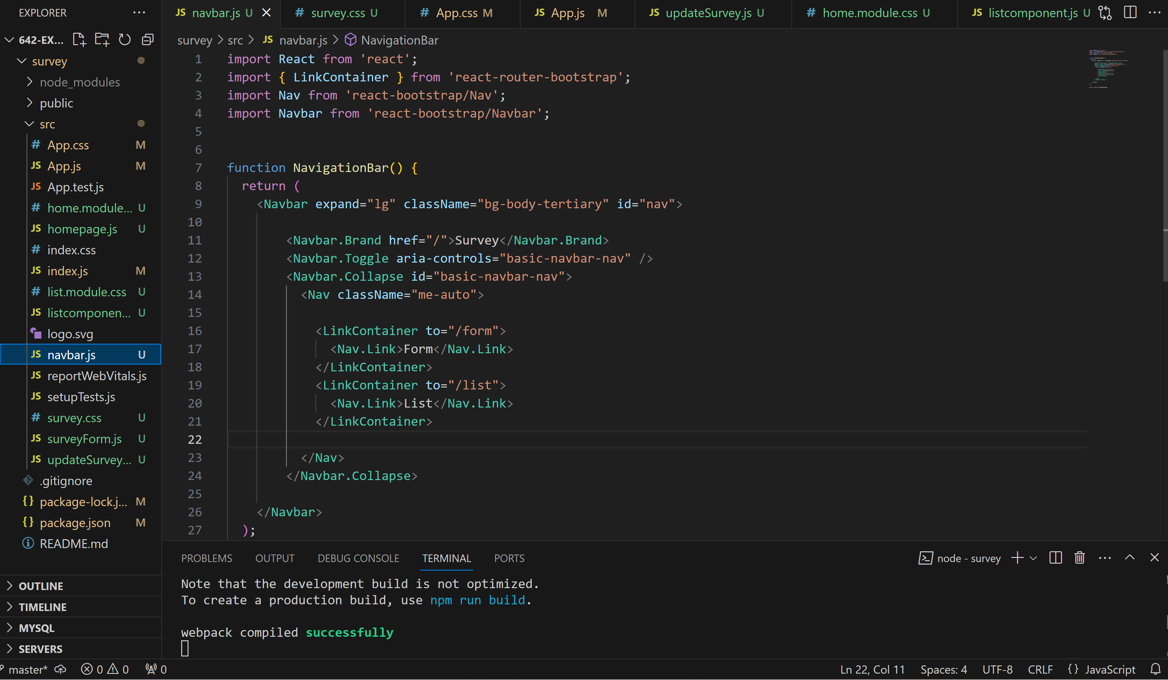
React Implementation – navbar.js

Slide 9
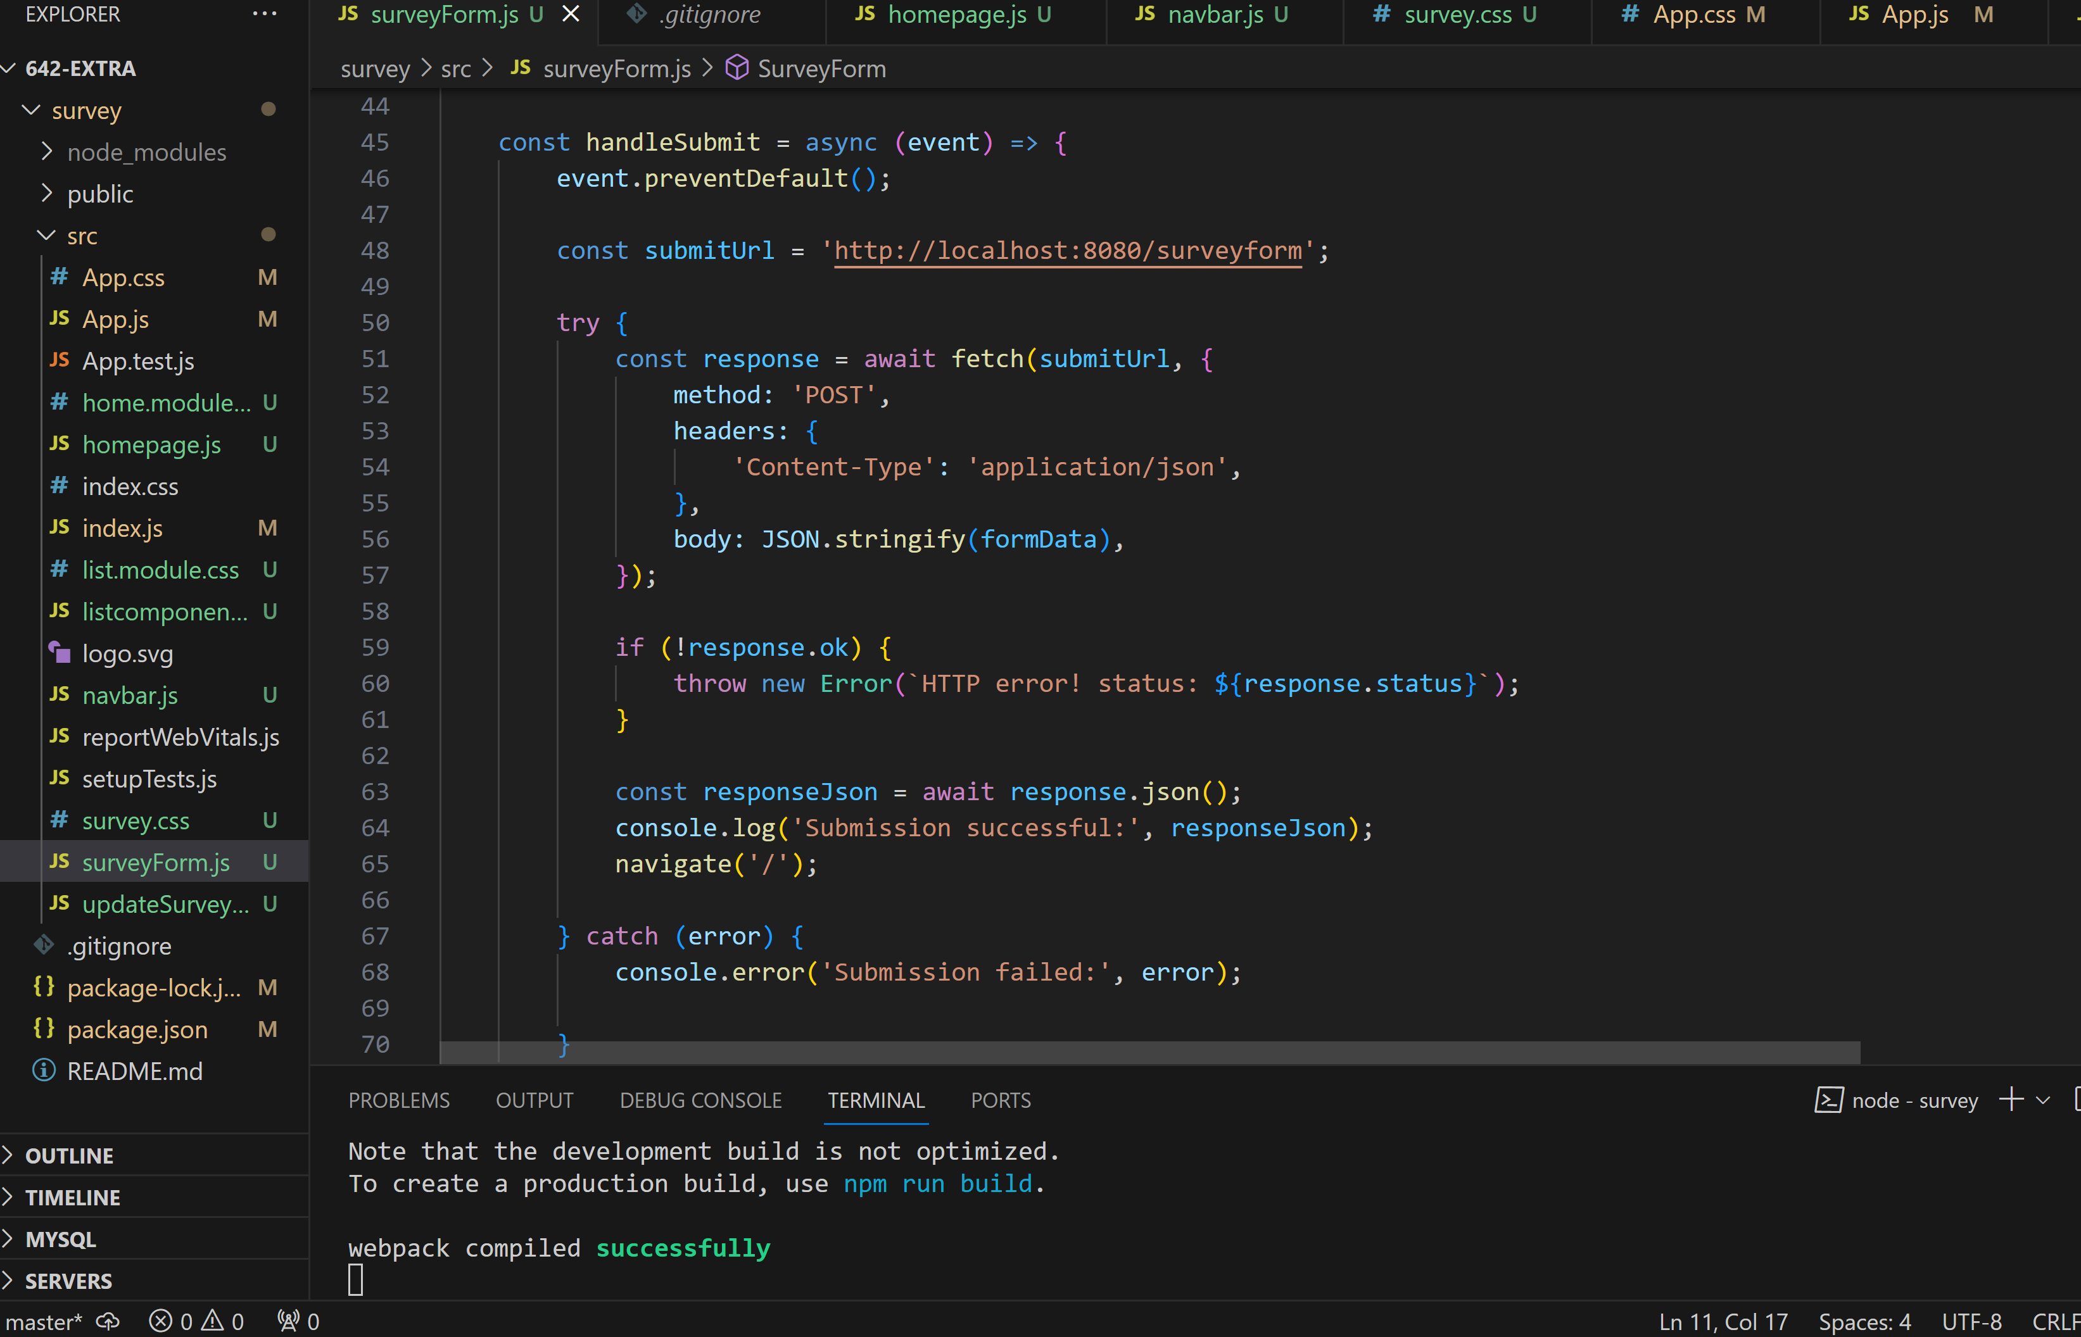
React Implementation – surveyForm.js

Slide 10
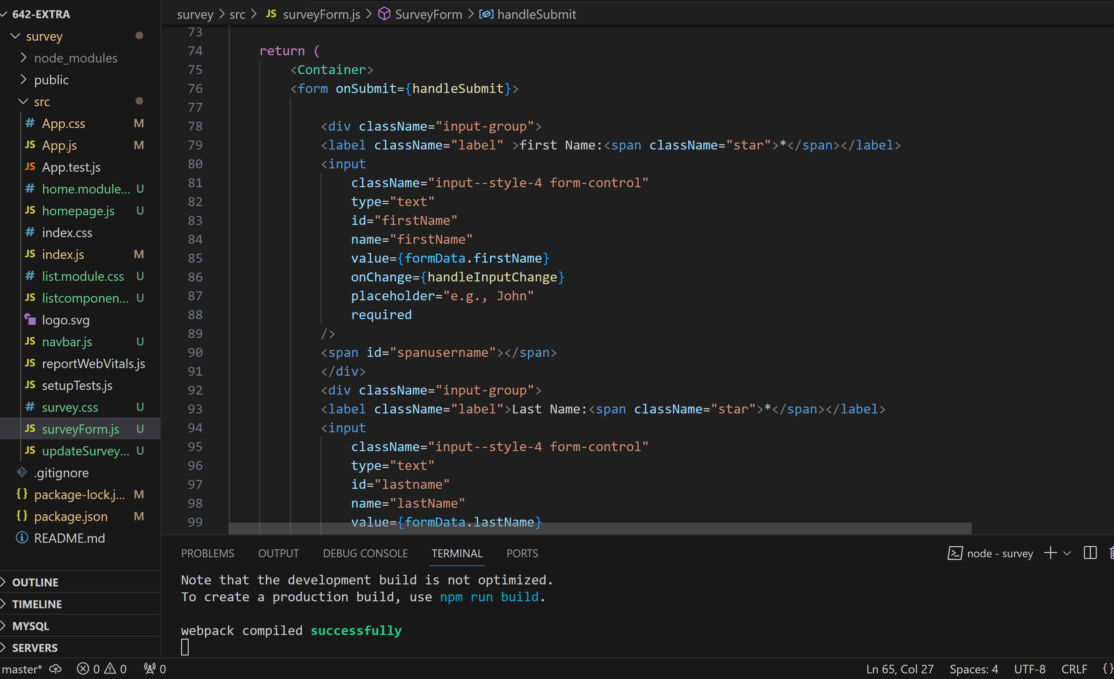
React Implementation – surveyForm.js

Slide 11
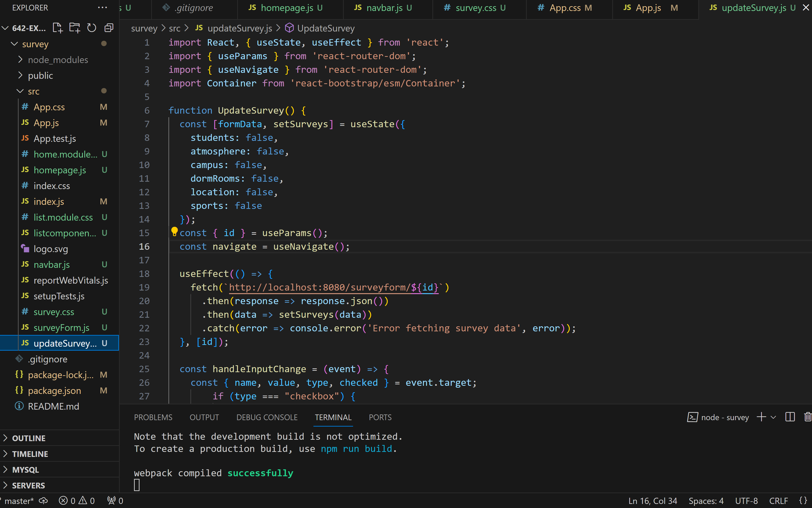
React Implementation – updateSurvey.js

Slide 12
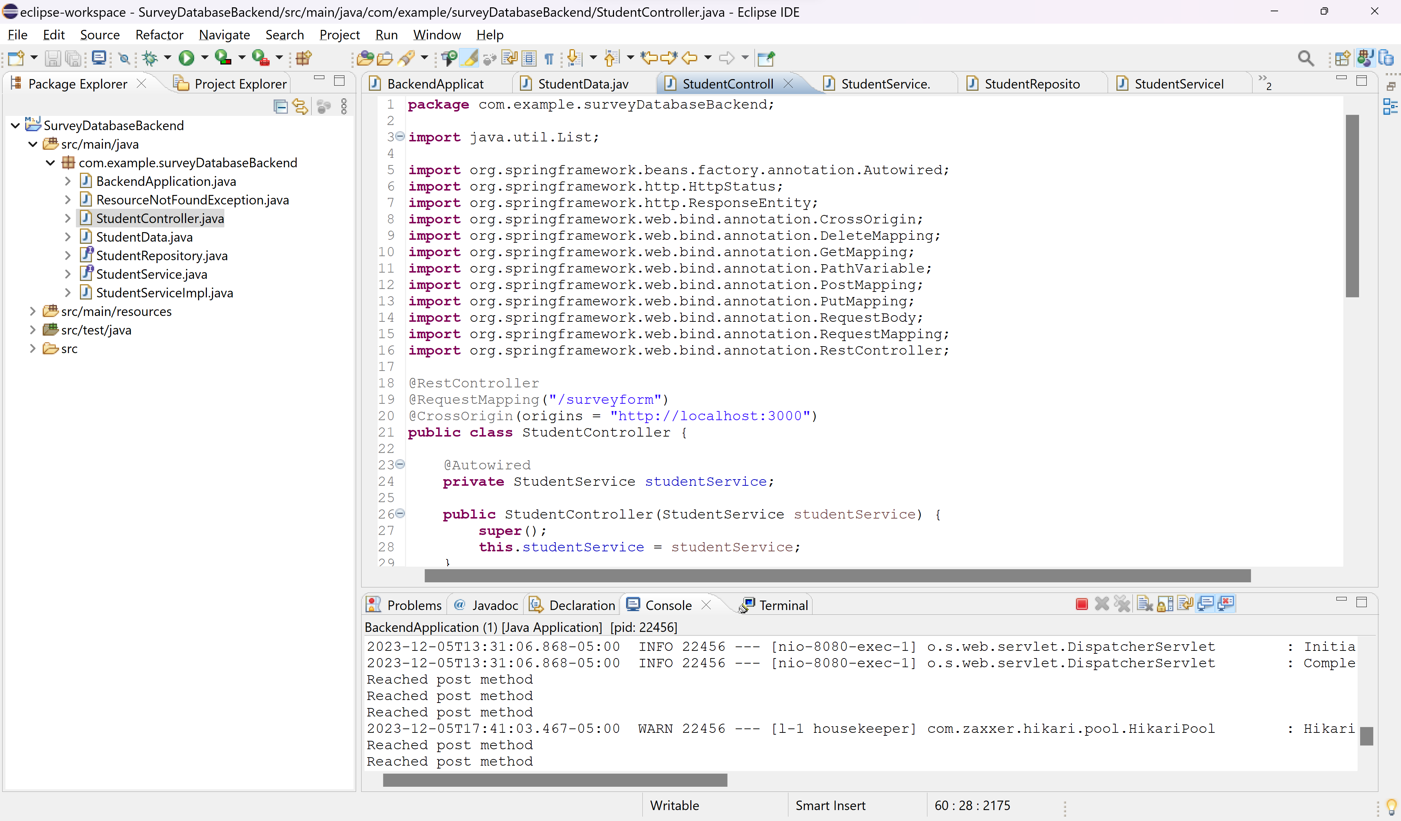
Springboot.js

Slide 13
React Vs Angular
React is more flexible as it focuses more on the UI components. It’s easier to integrate it with different libraries and architecture patterns whereas angular is full-fledged MVC framework and has a little complex structure.
React is best for dynamic and responsive UI and angular is better for large-scale applications because of its comprehensive framework.
React uses javascript and Angular uses typescript.
React has hooks for managing state and it supports one-way binding whereas angular is two-way binding.

Slide 14
Thank you!

